Slide 2
CONTENTS: 1.THE SOUTHERN PLATEAU THE CENTRAL HIGHLAND AND THE DECCAN PLATEAU 2.LIFE IN THE REGION 3.THE ISLANDS THE ANDAMAN AND NICOBAR ISLANDS THE LAKSHADWEEP ISLANDS
5.THE SOUTHERN PLATEAUS AND THE ISLANDS

Slide 3
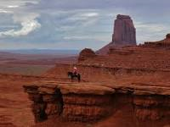
. https://www.youtube.com/watch?v=7jR_24Dcev4 The Deccan Plateau is a triangular landmass. It lies to the south of the river Narmada. Plateau A plateau is a large area of high and fairly flat land. It is also called Tableland.
THE SOUTHERN PLATEAU

Slide 4
LOCATION OF SOUTHERN PLATEAU
Deccan, the entire southern peninsula of India south of the Narmada River, marked centrally by a high triangular tableland. The name derives from the Sanskrit daksina (“south”). The plateau is bounded on the east and west by the Ghats
The two parts of the southern plateau divided by the river Narmada are
The central Highlands and
The Deccan Plateau
CHAPTER 5/KARUNAMBIGAI/SOCIAL DEPT/SNS ACADEMY

Slide 5
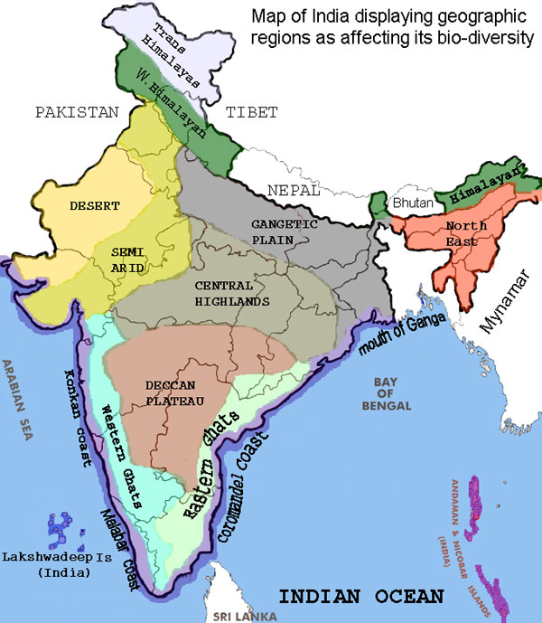
THE CENTRAL HIGHLANDS The Aravalli Hills – North west The vindhya Range - South The Rajmahal Hills – North east The Chota Nagpur Plateau - East
Chapter 4/social/karunambigai/Sns Academy

Slide 6
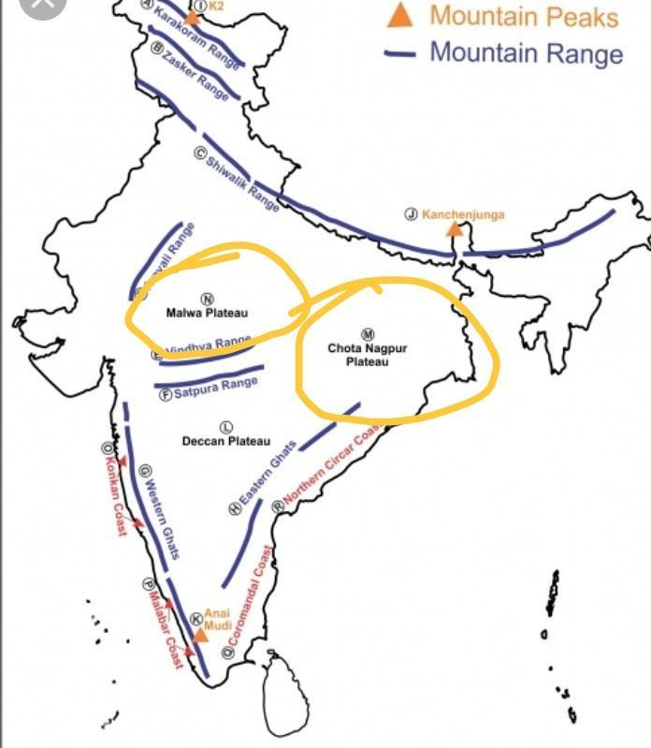
THE MALWA PLATEAU - CENTRE THE IMPORTANT RIVERS IN THIS REGION ARE CHAMBAL,BETWA SIND AND SON. THE STATES ARE JHARKHAND ,NORTHERN ODISHA AND NORTH-EASTERN CHHATTISGARH. LARGE DEPOSITS OF COAL AND OTHER MINERALS.
THE CENTRAL HIGHLAND

Slide 7
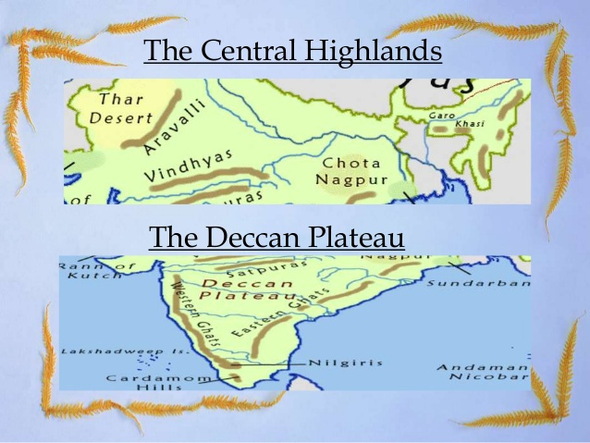
EXTENDS FROM RIVER NARMADA TO THE SOUTHERN TIP OF PENINSULAR INDIA. ANAIMUDI IS THE HIGHEST PEAK. EASTERN AND WESTERN GHATS MEET AT NILGIRI HILLS. THE IMPORTANT RIVERS ARE GODAVARI,KRISHNA AND KAVERI. GODAVARI IS THE LONGEST RIVER IN THE DECCAN PLATEAU.
THE DECCAN PLATEAU

Slide 8
LIFE IN THE REGION –MINING AND FARMING
STATES | OCCUPATIONS | INDUSTRIES | LANGUAGE/TOURIST | MINERALS | FESTIVALS/DANCES
MADHYA PRADESH | FARMING AND MAT WEAVING | PANNA | PACHMARI,SANCHI | DIAMOND MINES | -
CHHATTISGARH |  | BHILAI |  | TIN | SAILA
JHARKHAND |  | JAMSHEDPUR | NATARHAT |  | CHHAU
TELANGANA | BIDRI WORK | IT,AUTOMOBILES AND PHARMACEUTICALS | TELEGU |  | KUCHIPUDI
KARNATAKA |  | IT | KANNADA | GOLD | YAHSHAGANA
MAHARASTRA |  | MUMBAI AND PUNE | MARATHI | PETROLEUM | GANESH CHATURTHI/LAVANI

Slide 9
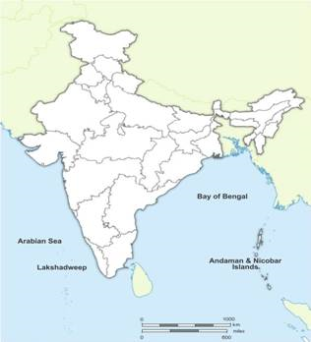
ANDAMAN AND NICOBAR ISLANDS LAKSHADWEEP ISLANDS
ISLANDS

Slide 10
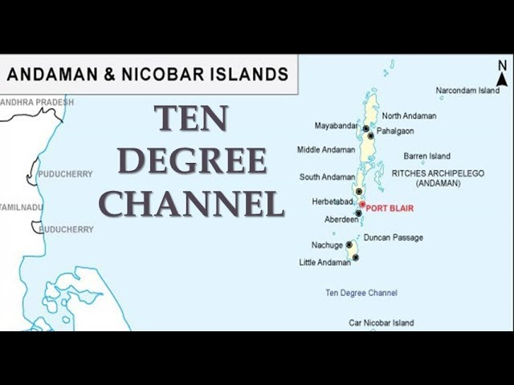
ANDAMAN AND NICOBAR ISLANDS
ANDAMAN AND NICOBAR ARE IN BAY OF BENGAL.
TEN DEGREE CHANNEL SEPARATES ANDAMAN AND NICOBAR.
FISHING AND FARMING ARE MAIN OCCUPATIONS.
RICE IS THE MAIN CROP.
COCONUT AND ARECANUT ARE GROWN IN NICOBAR ISLANDS.
THEY SPEAK BANGLA.

Slide 11
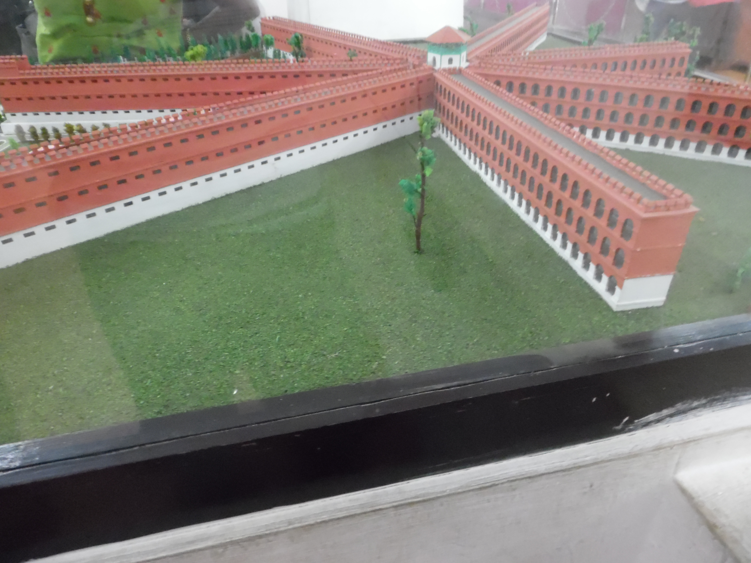
.
TOURIST ATTRACTION

Slide 12
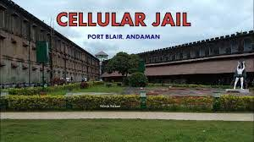
CELLULAR JAIL

Slide 13
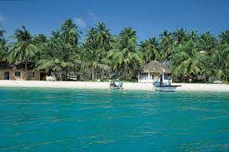
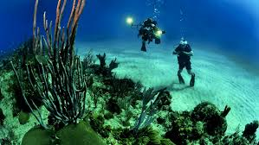
A GROUP OF ISLANDS IN THE ARABIAN SEA. FISHING IS THE MAIN OCCUPATION. COCONUT IS THE MAIN CROP. PEOPLE SPEAK MALAYALAM.
LAKSHADWEEP ISLAND

